Slide 1
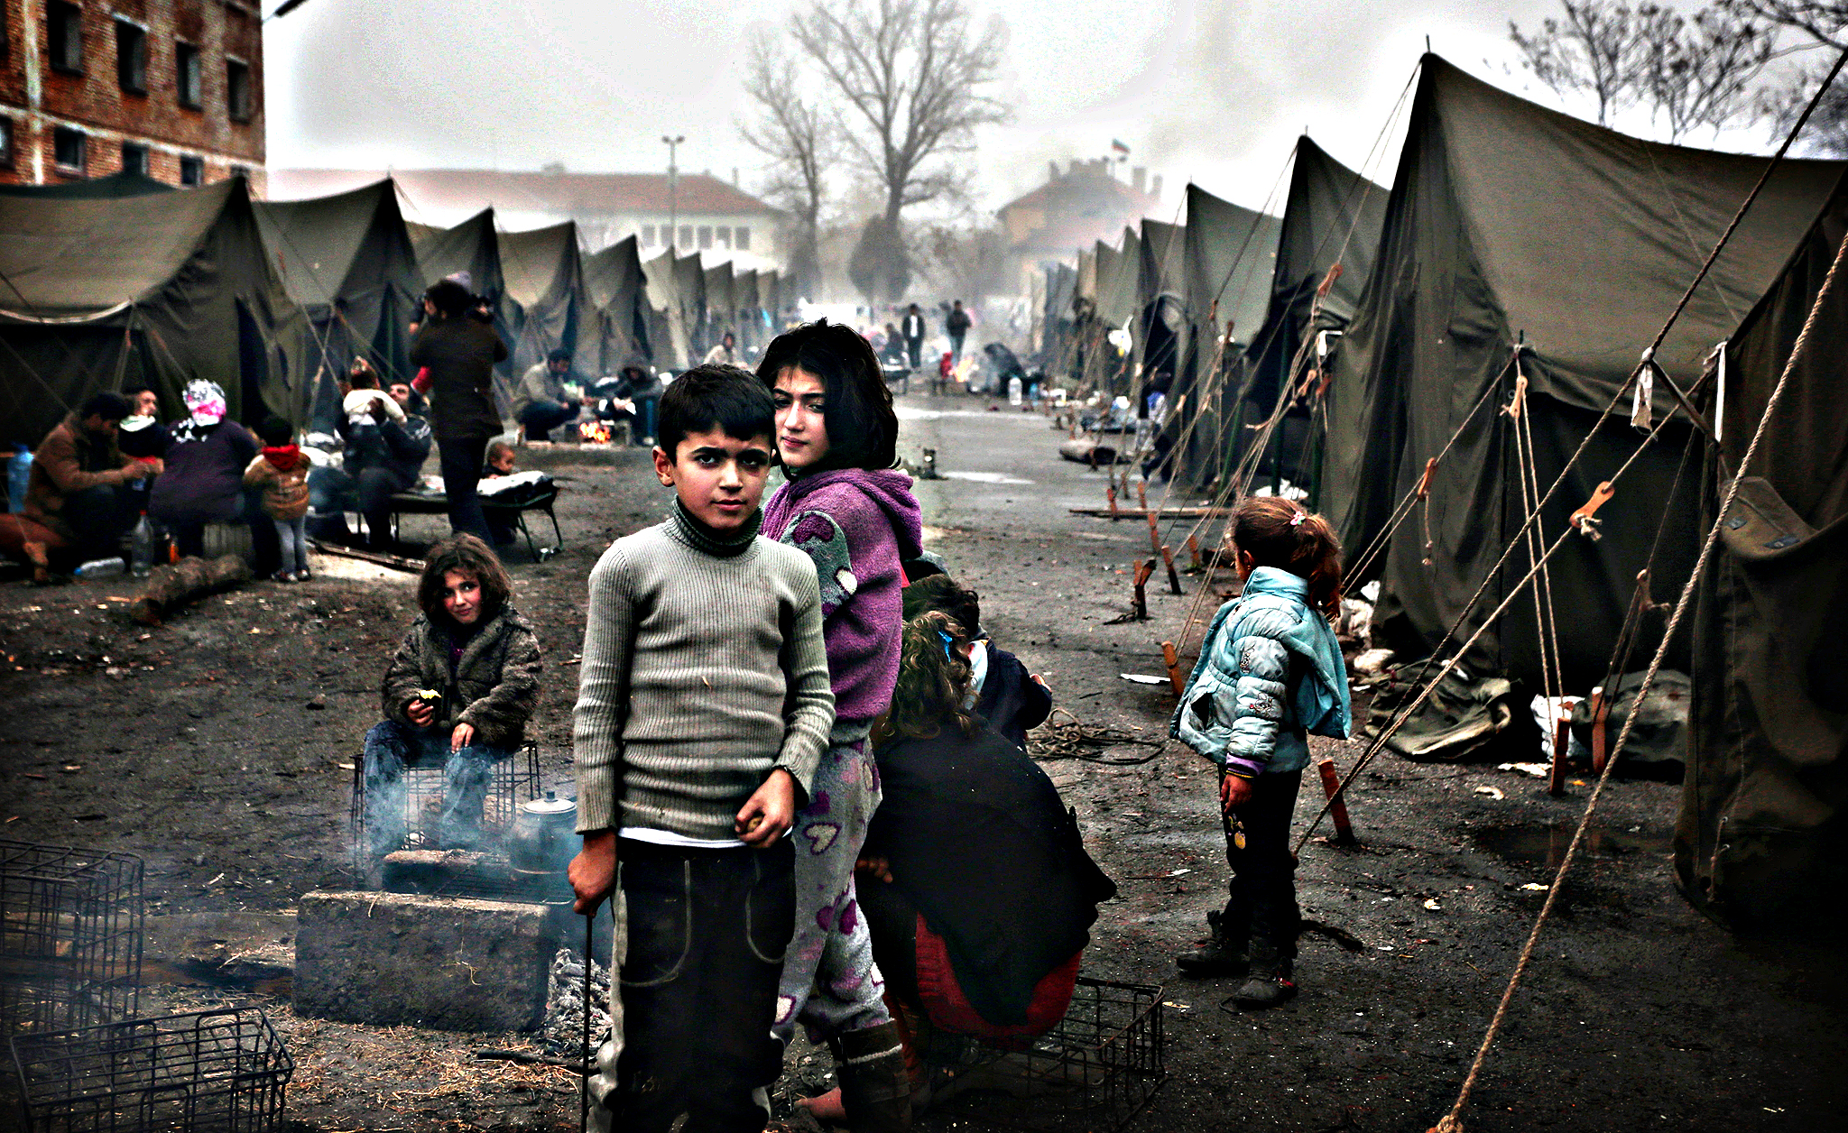
Predicting Demographic Trends of UNHCR Persons of Concern Globally
Better preparing for displacement services

Slide 2
Predicting displacement at the demographic level is useful to better the specificity of services
We are currently facing the largest refugee crisis in human history
Data Science and Machine Learning from publicly available data can help build robust government and organization assistance programs
For example, knowing the total number of early-age adolescents can help prepare for developmental programs
Using regression techniques can help predict future trends at the level of age and gender

Slide 3
Data Acquisition and cleaning
Data was pulled from the United Nations Refugee Agency database (found here) as a .csv
The raw dataset included the total numbers of persons of concern by country of asylum/residence and demographic since 2001
Data cleaning included removing asterisks, combining necessary demographics, renaming countries as needed and removing countries that only had a single datapoint

Slide 4
Machine Learning
Simple Linear Regression was utilized across all countries and demographics, R² was maximized to get the best fit
Sklearn library was the engine to create linear regression objects
Dataframe generated that includes linear regression objects for easy calculation in predictive analytics

Slide 5
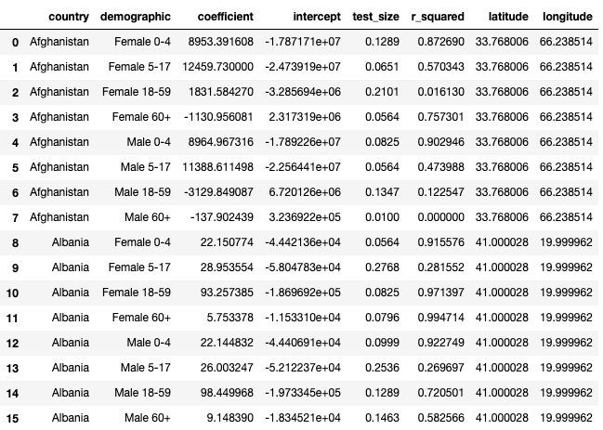
Generated dataframe
Includes country and demographic, linear regression object values and geographic locations

Slide 6
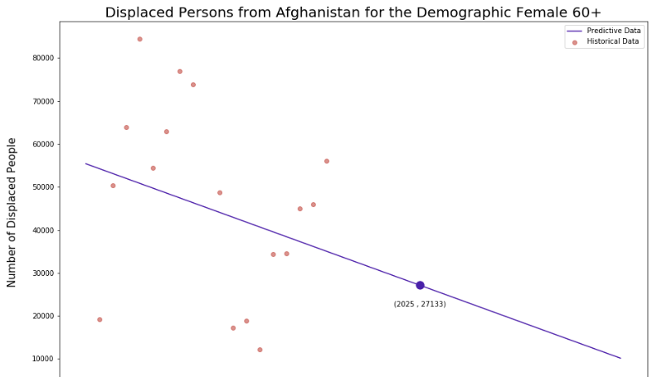
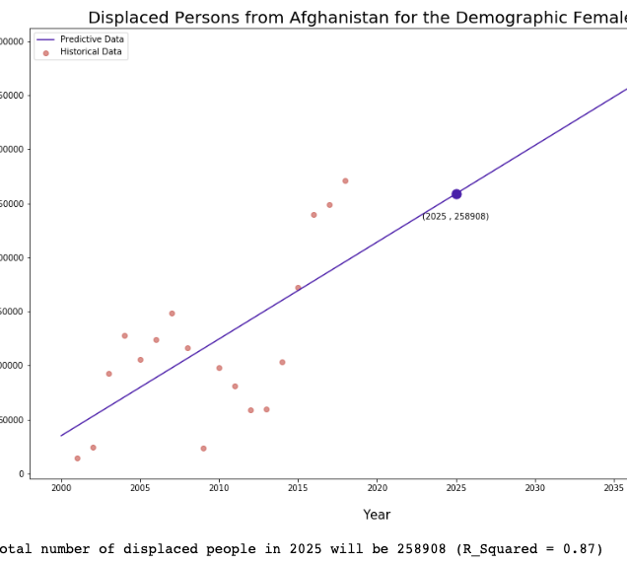
Demographics trends within the same country can shift massively
Women displaced in Afghanistan vary widely – younger women are being displaced at a much greater rate than older women

Slide 7
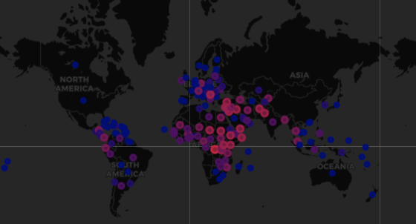
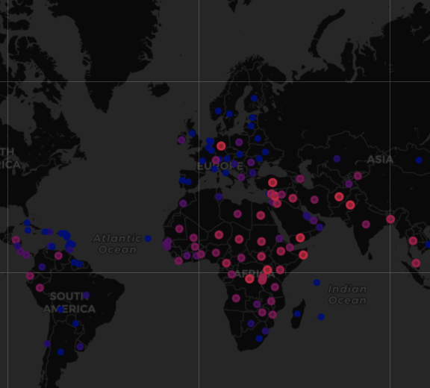
Global Displacement Trends
Women ages 0 – 4 are primarily being displaced in parts of Central America, Sub-Saharan Africa, the Middle East and Southeast Asia

Slide 8
Conclusion and future direction
Scaffold was developed to calculate regressions across countries and demographics for UNHCR persons of concern
Demographic trends vary widely between countries
The predictive ability with the data available is incredibly low – longer time periods, more specific to ages and categorizing genderqueer / non-binary individuals correctly would better the output of prediction
As we gain more data and can include more complex regressive means, this model becomes significantly more useful

